Slide 1
Lesson 17
Creating Triggers

Slide 2
Objective
After completing this lesson, you should be able to:
  Describe database triggers and their uses
  Describe the different types of triggers
  Create database triggers
  Describe database trigger-firing rules
  Remove database triggers
  Display trigger information

Slide 3
Lesson Agenda
  Understanding the usage of triggers
  Creating triggers
  Creating row-level triggers
  Creating INSTEAD OF triggers
  Managing Triggers

Slide 4





Hey Alice, I have a situation where I have to keep track of the amount of salary increase given to an employee whenever it is given. I can request the managers to update a certain table whenever they give a hike, but usually they forget about this update. Can you automate this?
I can definitely create something for this requirement. So, friends, let’s get to work!
We have triggers in PL/SQL that can help us in creating something that the HR manager has asked for. Let’s look at the concept first.

Slide 5
What are Triggers?
  A trigger is a PL/SQL block that is stored in the database and fired (executed) in response to a specified event.
  The Oracle database automatically executes a trigger when specified conditions occur.

Slide 6







Defining Triggers
A trigger can be defined on the table, view, schema (schema owner), or database (all users).
Table
View
Database (All users)

Slide 7
Why do you use Triggers?
You might use a trigger for one of the following purposes:
  To log events
  To gather statistics on table access
  To modify table data when DML statements are issued against views
  To enforce referential integrity constraints when child and parent tables are on different nodes
  To prevent DML operations on a table based on application requirements
  To prevent invalid transactions
  To implement complex business rules

Slide 8
Trigger Event Types
You can write triggers that fire whenever one of the following operations occurs in the database:
DML Statements
DDL Statements
Database Events
  DELETE
  INSERT
  UPDATE
  CREATE
  ALTER
  DROP
  SERVERERROR
  LOGON
  LOGOFF
  STARTUP
  SHUTDOWN

Slide 9


Available Trigger Types
  Simple DML triggers
    BEFORE
    AFTER
    INSTEAD OF
  Compound triggers
  System triggers
    DDL event triggers
    Database event triggers
Application triggers
Database triggers

Slide 10
Trigger Event Types and Body
  A trigger event type determines which DML statement causes the trigger to execute. The possible events are:
    INSERT
    UPDATE [OF column]
    DELETE
  A trigger body determines what action is performed and is a PL/SQL block or a CALL to a procedure.

Slide 11

Creating DML Triggers by Using the CREATE TRIGGER Statement
CREATE [OR REPLACE] TRIGGER trigger_name
timing –- when to fire the trigger
event1 [OR event2 OR event3]
ON object_name
[REFERENCING OLD AS old | NEW AS new]
FOR EACH ROW –- default is statement level trigger
WHEN (condition)]]
DECLARE]
BEGIN
... trigger_body –- executable statements
[EXCEPTION . . .]
END [trigger_name];
timing = BEFORE | AFTER | INSTEAD OF
event = INSERT | DELETE | UPDATE | UPDATE OF column_list

Slide 12
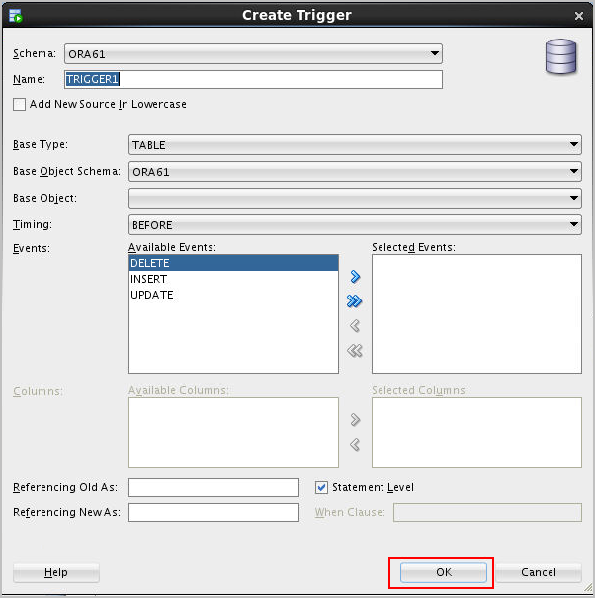
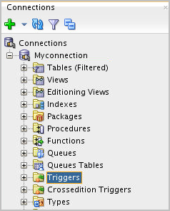
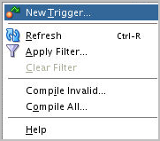
Creating DML Triggers by Using SQL Developer

Slide 13
Specifying the Trigger Execution Time
You can specify the trigger timing as to whether to run the trigger’s action before or after the triggering statement:
  BEFORE: Execute the trigger body before the triggering DML event on a table.
  AFTER: Execute the trigger body after the triggering DML event on a table.
  INSTEAD OF: Execute the trigger body instead of the triggering statement. This is used for views that are not otherwise modifiable.

Slide 14
Creating a DML Statement Trigger Example: SECURE_EMP

Slide 15



INSERT INTO EMPLOYEES...;
DML statement fires trigger
Application
SECURE_EMP trigger
CREATE OR REPLACE TRIGGER secure_emp
BEFORE INSERT ON employees
BEGIN
IF (TO_CHAR(SYSDATE,'DY') IN ('SAT','SUN')) OR
(TO_CHAR(SYSDATE,'HH24:MI') NOT BETWEEN '08:00' AND '18:00') THEN
RAISE_APPLICATION_ERROR(-20500, 'You may insert'
||' into EMPLOYEES table only during '
||' normal business hours.');
END IF;
END;

Slide 16

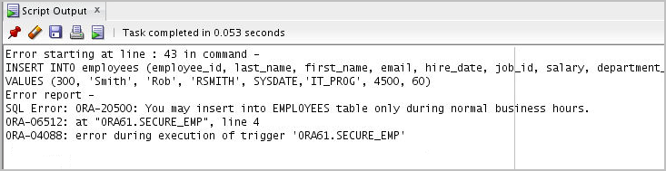
Testing Trigger SECURE_EMP
INSERT INTO employees (employee_id, last_name,first_name, email, hire_date, job_id, salary, department_id)
VALUES (300, 'Smith', 'Rob', 'RSMITH', SYSDATE,'IT_PROG', 4500, 60);

Slide 17

Using Conditional Predicates
CREATE OR REPLACE TRIGGER secure_emp BEFORE
INSERT OR UPDATE OR DELETE ON employees
BEGIN
IF (TO_CHAR(SYSDATE,'DY') IN ('SAT','SUN')) OR
(TO_CHAR(SYSDATE,'HH24')
NOT BETWEEN '08' AND '18') THEN
IF DELETING THEN RAISE_APPLICATION_ERROR(
-20502,'You may delete from EMPLOYEES table'||
'only during normal business hours.');
ELSIF INSERTING THEN RAISE_APPLICATION_ERROR(
-20500,'You may insert into EMPLOYEES table'||
'only during normal business hours.');
ELSIF UPDATING ('SALARY') THEN
RAISE_APPLICATION_ERROR(-20503, 'You may '||
'update SALARY only normal during business hours.');
ELSE RAISE_APPLICATION_ERROR(-20504,'You may'||
' update EMPLOYEES table only during'||
' normal business hours.');
END IF;
END IF;
END;

Slide 18
Multiple Triggers of the Same Type
  You can have multiple triggers defined for a timing instance.
  To resolve the sequence of execution, you can use:
    PRECEDES
    FOLLOWS
  To execute trigger2 after trigger1 for a table employees BEFORE UPDATE, you may write it syntactically as:
  CREATE OR REPLACE TRIGGER2 ON EMPLOYEES BEFORE UPDATE
  FOLLOWS TRIGGER1...

Slide 19


CALL Statements in Triggers
CREATE [OR REPLACE] TRIGGER trigger_name
timing
event1 [OR event2 OR event3]
ON table_name
[REFERENCING OLD AS old | NEW AS new]
[FOR EACH ROW]
[WHEN condition]
CALL procedure_name
/
CREATE OR REPLACE PROCEDURE log_execution IS
BEGIN
DBMS_OUTPUT.PUT_LINE('log_execution: Employee Inserted');
END;
/
CREATE OR REPLACE TRIGGER log_employee
BEFORE INSERT ON EMPLOYEES
CALL log_execution –- no semicolon needed
/

Slide 20
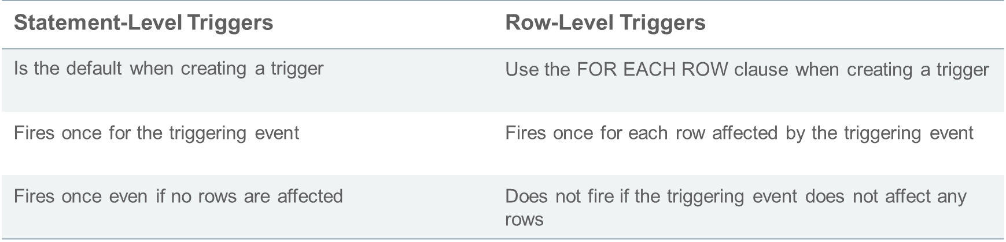
Statement-Level Triggers Versus Row-Level Triggers

Slide 21




In a situation where I have to log insertion of every row while inserting a bunch of 100 rows, I will use a
row-level trigger.
While creating the trigger, I add FOR EACH ROW in the syntax.
In a situation where I have to check the date and time of insertion and then allow it if it is in a valid range, I will use a statement-level trigger.

Slide 22


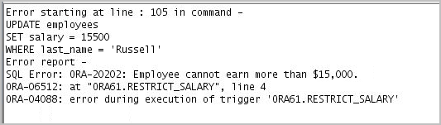
Creating a DML Row Trigger
CREATE OR REPLACE TRIGGER restrict_salary
BEFORE INSERT OR UPDATE OF salary ON employees
FOR EACH ROW
BEGIN
IF NOT (:NEW.job_id IN ('AD_PRES', 'AD_VP'))
AND :NEW.salary > 15000 THEN
RAISE_APPLICATION_ERROR (-20202,
'Employee cannot earn more than $15,000.');
END IF;
END;
UPDATE employees
SET salary = 15500
WHERE last_name = 'Russell';

Slide 23
Correlation names and Pseudorecords
  Correlation names are used to refer to values of a column before and after the trigger firing event.
  There are three different correlation names – OLD, NEW, and PARENT
  Pseudorecords refer to the values of the rows before and after the trigger-firing event when they are manipulated in the trigger body as a record.
  Pseudorecords are also referred to with OLD, NEW, and PARENT qualifiers.

Slide 24
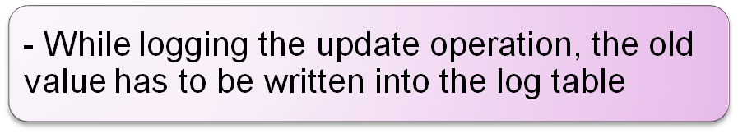
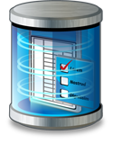
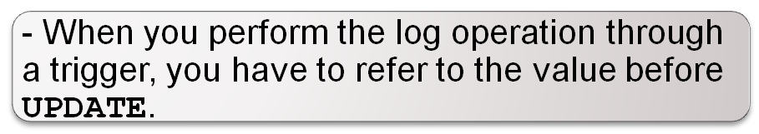
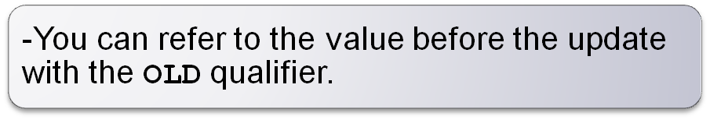
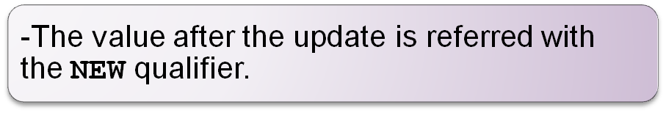
Correlation Names and Pseudorecords
Let us consider the logging of update operation by a logging utility in the database.

Slide 25
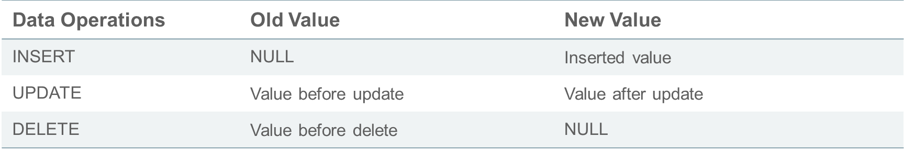
Using OLD and NEW Qualifiers
  When a row-level trigger fires, the PL/SQL runtime engine creates and populates two data structures:
    OLD: Stores the original values of the record processed by the trigger
    NEW: Contains the new values
  NEW and OLD have the same structure as a record declared by using the %ROWTYPE on the table to which the trigger is attached.

Slide 26
Using OLD and NEW Qualifiers: Example
CREATE TABLE audit_emp (
user_name VARCHAR2(30),
time_stamp date,
id NUMBER(6),
old_last_name VARCHAR2(25),
new_last_name VARCHAR2(25),
old_title VARCHAR2(10),
new_title VARCHAR2(10),
old_salary NUMBER(8,2),
new_salary NUMBER(8,2) )
/
CREATE OR REPLACE TRIGGER audit_emp_values
AFTER DELETE OR INSERT OR UPDATE ON employees
FOR EACH ROW
BEGIN
INSERT INTO audit_emp(user_name, time_stamp, id,
old_last_name, new_last_name, old_title,
new_title, old_salary, new_salary)
VALUES (USER, SYSDATE, :OLD.employee_id,
:OLD.last_name, :NEW.last_name, :OLD.job_id,
:NEW.job_id, :OLD.salary, :NEW.salary);
END;

Slide 27

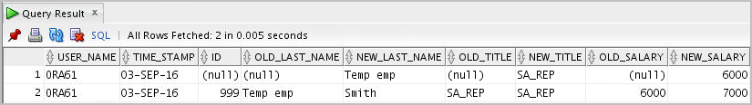
Using OLD and NEW Qualifiers: Example
INSERT INTO employees (employee_id, last_name, job_id, salary, email, hire_date)
VALUES (999, 'Temp emp', 'SA_REP', 6000, 'TEMPEMP', TRUNC(SYSDATE))
/
UPDATE employees
SET salary = 7000, last_name = 'Smith'
WHERE employee_id = 999
/
SELECT *
FROM audit_emp;

Slide 28

Using the WHEN Clause to Fire a Row Trigger Based on a Condition
CREATE OR REPLACE TRIGGER derive_commission_pct
BEFORE INSERT OR UPDATE OF salary ON employees
FOR EACH ROW
WHEN (NEW.job_id = 'SA_REP')
BEGIN
IF INSERTING THEN
:NEW.commission_pct := 0;
ELSIF :OLD.commission_pct IS NULL THEN
:NEW.commission_pct := 0;
ELSE
:NEW.commission_pct := :OLD.commission_pct+0.05;
END IF;
END;
/

Slide 29

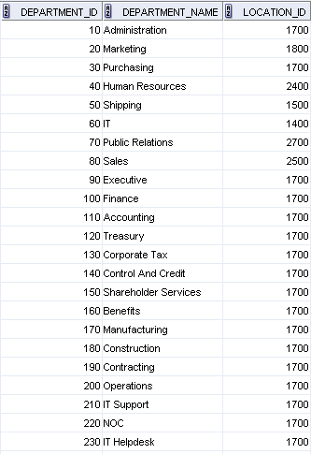
Trigger-Firing Sequence: Single-Row Manipulation
Use the following firing sequence for a trigger on a table when a single row is manipulated:
INSERT INTO departments
(department_id,department_name, location_id)
VALUES (400, 'CONSULTING', 2400);
BEFORE statement trigger
. . .
BEFORE row trigger
AFTER row trigger
AFTER statement trigger

Slide 30

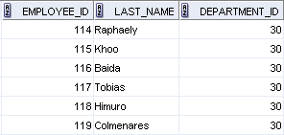
Trigger-Firing Sequence: Multirow Manipulation
Use the following firing sequence for a trigger on a table when many rows are manipulated
UPDATE employees
SET salary = salary * 1.1
WHERE department_id = 30;
BEFORE statement trigger
BEFORE row trigger
AFTER row trigger
. . .
BEFORE row trigger
AFTER row trigger
. . .
AFTER statement trigger

Slide 31
Summary of the Trigger Execution Model
  Execute all BEFORE STATEMENT triggers.
  Loop for each row affected by the SQL statement:
    Execute all BEFORE ROW triggers for that row.
    Execute the DML statement and perform integrity constraint checking for that row.
    Execute all AFTER ROW triggers for that row.
  Execute all AFTER STATEMENT triggers.

Slide 32





INSTEAD OF Triggers
Application
INSERT INTO my_view
. . . ;
INSERT
TABLE 1
INSTEAD OF trigger
UPDATE
MY_VIEW
TABLE 2

Slide 33


Creating an INSTEAD OF Trigger: Example
INSERT INTO emp_details
VALUES (9001,'ABBOTT',3000, 10, 'Administration');
2
INSERT into
NEW_EMPS table
1
3
EMP_DETAILS view

Slide 34

Creating an INSTEAD OF Trigger to Perform DML on Complex Views
CREATE TABLE new_emps AS
SELECT employee_id,last_name,salary,department_id
FROM employees;
CREATE TABLE new_depts AS
SELECT d.department_id,d.department_name,
sum(e.salary) dept_sal
FROM employees e, departments d
WHERE e.department_id = d.department_id;
CREATE VIEW emp_details AS
SELECT e.employee_id, e.last_name, e.salary,
e.department_id, d.department_name
FROM employees e, departments d
WHERE e.department_id = d.department_id
GROUP BY d.department_id,d.department_name;

Slide 35

The Status of a Trigger
A trigger can be in either of the following distinct modes:
  Enabled: The trigger runs its trigger action if a triggering statement is issued and the trigger restriction (if any) evaluates to true (default).
  Disabled: The trigger does not run its trigger action, even if a triggering statement is issued and the trigger restriction (if any) would evaluate to true.

Slide 36
System Privileges Required to Manage Triggers
The following system privileges are required to manage triggers:
  The privileges that enable you to create, alter, and drop triggers in any schema:
    GRANT CREATE TRIGGER TO ora61
    GRANT ALTER ANY TRIGGER TO ora61
    GRANT DROP ANY TRIGGER TO ora61
  The privilege that enables you to create a trigger on the database:
    GRANT ADMINISTER DATABASE TRIGGER TO ora61
  The EXECUTE privilege (if your trigger refers to any objects that are not in your schema)

Slide 37


Managing Triggers by Using the ALTER and DROP SQL Statements
-- Disable or reenable a database trigger:
ALTER TRIGGER trigger_name DISABLE | ENABLE;
-- Disable or reenable all triggers for a table:
ALTER TABLE table_name DISABLE | ENABLE ALL TRIGGERS;
-- Recompile a trigger for a table:
ALTER TRIGGER trigger_name COMPILE;
-- Remove a trigger from the database:
DROP TRIGGER trigger_name;

Slide 38

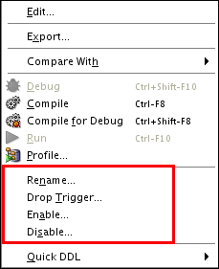
Managing Triggers by Using SQL Developer

Slide 39
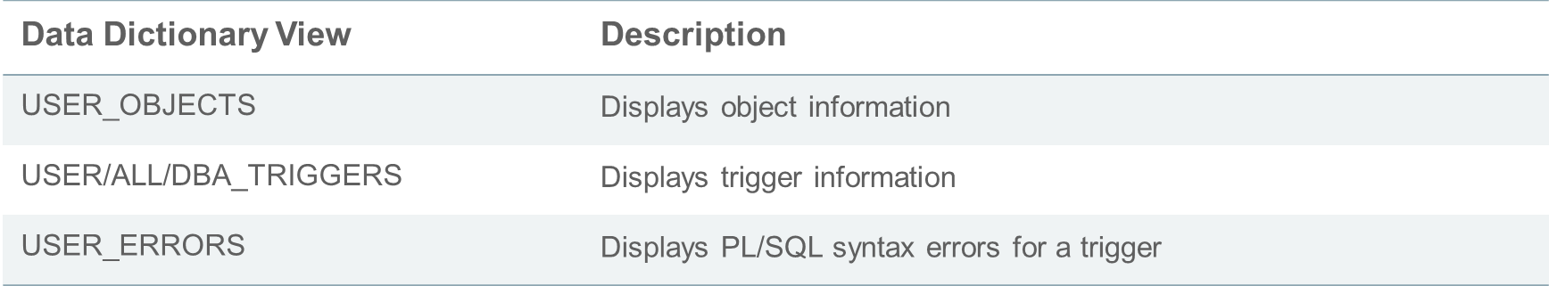
Viewing Trigger Information
You can view the following trigger information:

Slide 40

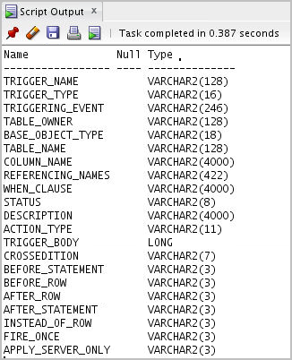

Using USER_TRIGGERS
DESCRIBE user_triggers
SELECT trigger_type, trigger_body
FROM user_triggers
WHERE trigger_name = 'SECURE_EMP';

Slide 41
Testing Triggers
  Test each triggering and non-triggering data operation.
  Test each case of the WHEN clause.
  Make the trigger fire directly from a basic data operation as well as indirectly from a procedure.
  Test the effect of the trigger on other triggers.
  Test the effect of other triggers on the trigger.

Slide 42
Quiz
A triggering event can be one or more of the following:
  An INSERT, UPDATE, or DELETE statement on a specific table (or view, in some cases)
  A CREATE, ALTER, or DROP statement on any schema object
  A database startup or instance shutdown
  A specific error message or any error message
  A user logon or logoff

Slide 43
Summary
In this lesson, you should have learned how to:
  Create database triggers that are invoked by DML operations
  Create statement and row trigger types
  Use database trigger-firing rules
  Enable, disable, and manage database triggers
  Develop a strategy for testing triggers
  Remove database triggers

